Slide 1
Differing Opinions on University Waste Management within the International Cohort.
Isaac Berger

Slide 2
Is there a gap international students face in the understanding and usage of available recycling services at the LSE?
The LSE is one of the most eminent cosmopolitan universities.
New students face infrastructure in an unfamiliar country.
Takeaway food and drink are part of the culture of focused work and study.

Slide 3
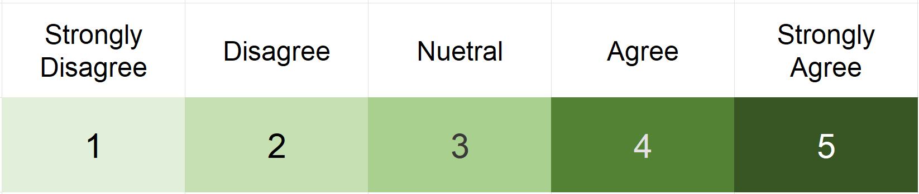
An Overview of the Dataset
83 Survey responses (73 paper surveys, 8 online).
20 of the 27 Departments that Provide Courses are represented.
48 Undergraduate responses, 34 Postgraduate.
Gathered predominantly Likert-scale responses. The following slides contain tables showing mean numerical responses using a 1 to 5 system.
Where respondents spent “most of their time” prior to the LSE

Slide 4
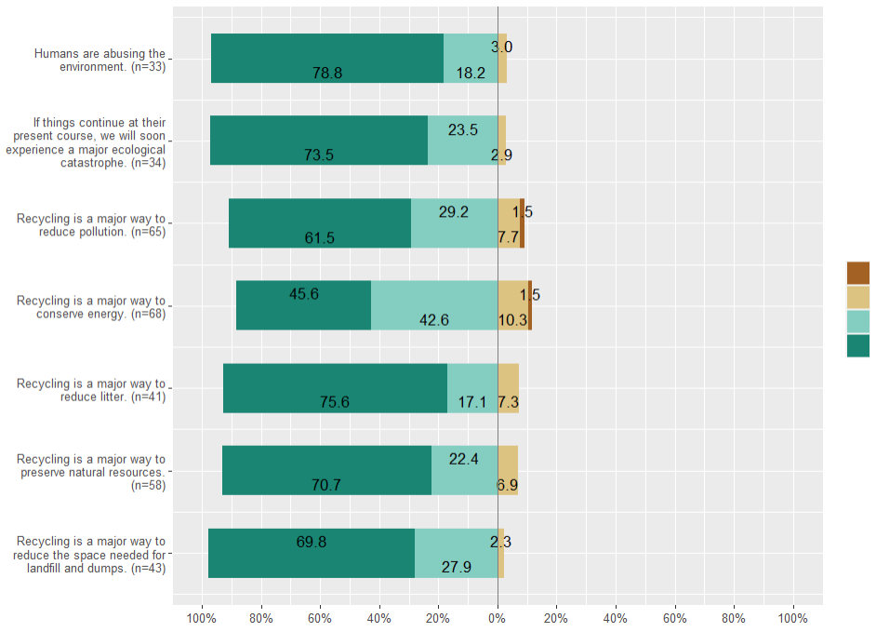
Regardless of national background, LSE represents a concerned generation.
40% of all statements questioning the relevance of environmental practices responded with “strongly agree”. This was too large to plot.
Given students have a clear motivation to engage in recycling, does a deficit in understanding university recycling services rest in the effects of coming from another country?
Strongly Disagree Disagree Neutral Agree

Slide 5
A Comparison between UK and International Students
In what country did you spend most of your life prior to joining LSE? If your time was split evenly, please detail multiple. (Q4)
 | UK (n=22) | China (n=10) | All Other International Students (n=48)
On campus, I recycle as much as I can. (D1) | 3.81 | 4 | 4.11
I am certain about what materials go in which bin. (D2) | 3.43 | 3.6 | 3.46
I am satisfied with the design of the waste-separation bins in general. (D4) | 3.14 | 3.9 | 3.52
I trust the university recycling service to send my waste to the correct processing facilities. (D7) | 2.71 | 4.2 | 3.64
UK students are more dissatisfied with recycling on campus despite informational advantages.
Consistent across nationalities is that there is uncertainty about which materials can be recycled.

Slide 6
Familiarity with Public Recycling Services prior to University
Where you spent most of your time prior to LSE was there a publicly available recycling service? (A1)
 | Public Recycling Prior to LSE (n=61) | NO Public Recycling Prior to LSE (n=13)
On campus, I recycle as much as I can. (D1) | 4.12 | 3.75
I am certain about what materials go in which bin. (D2) | 3.55 | 3.33
I am satisfied with the design of the waste-separation bins in general. (D4) | 3.5 (1% Difference)
The university should put in more effort to promote waste recycling on campus. (D6) | 1.98 | 1.83
Three cases of notable disparity surrounding university recycling.
D1 displays a 10% difference, D6 (8.5%), and D2 (6.5%).
The NO subset is comprised of a diversity of countries, incl. the UK, Saudi Arabia, India, France and Kenya.

Slide 7
Familiarity with Public Recycling Services, Continued…
Where you spent most of your time prior to LSE was there a publicly available recycling service? (A1)
 | Public Recycling Prior to LSE (n=61) | NO Public Recycling Prior to LSE (n=13)
I am certain about what materials go in which bin. (D2) | 3.55 | 3.33
I am satisfied with the design of the waste-separation bins in general. (D4) | 3.5 (Dif. 1%)
I trust the university recycling service to send my waste to the correct processing facilities. (D7) | 3.45 (Dif. 3.5%)
This slide brings to attention the lower mean scores related to LSE’s recycling.
I have time to think about how to recycle my day-to-day waste (C6). The mean score for this was 3.3, much lower than any other control variable.
The university should put in more effort to promote waste recycling on campus. (D6) | 1.98 | 1.83

Slide 8
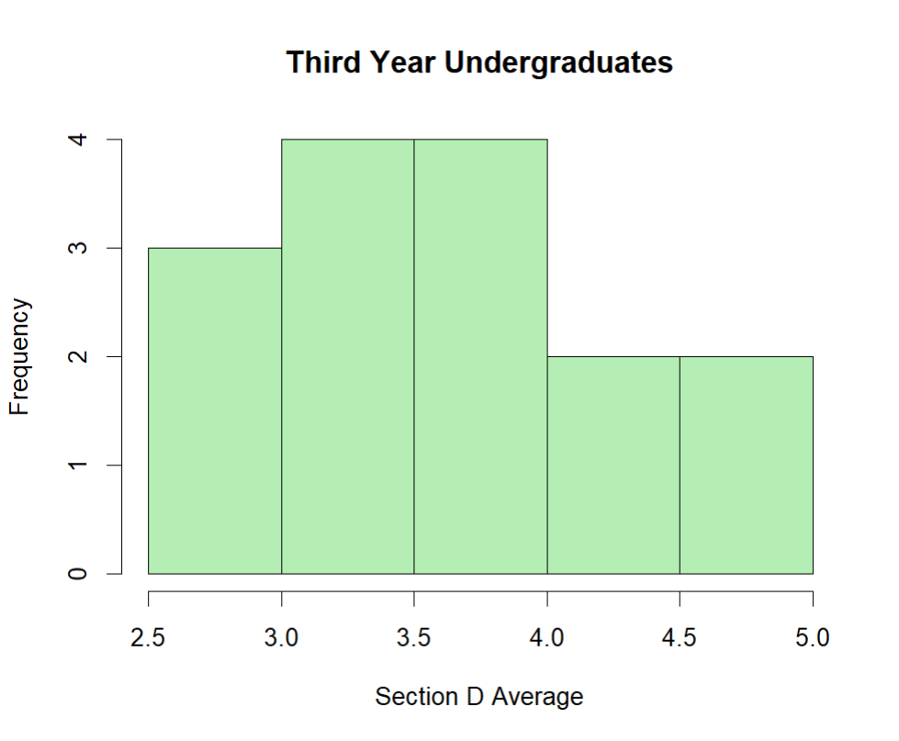
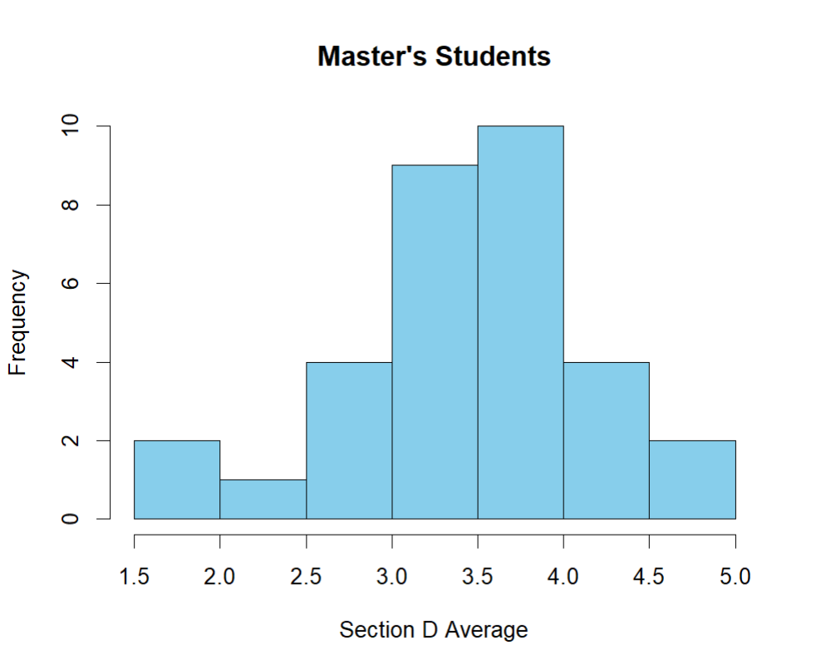
The time students spend at the LSE has a nominal impact.
15 observations from third-year international students give an average of 3.57
Twice as many observations from international master’s students give an average of 3.48
This challenges assumptions that those studying multi-year courses invest time towards understanding local recycling.

Slide 9
Numbers indicate the mean scores for section D, given that :
 | Recycling Services ARE publicly available. | Recycling Services are NOT publicly available.
LOWEST 25% of marks for Section C | 3.31 | 2.57
HIGHEST 25% of marks for section C | 3.32 | 3.82

Slide 10
Suggested Policy Prescriptions
Posters in high footfall areas giving common examples of incorrect recycling practices. Could further give examples of the damage that incorrectly sorted waste inflicts on recycling facilities.
Introductory surveys distributed in halls of residences could ask whether there was a recycling service where you spent most of your time prior to LSE. If so, a follow-up email could be distributed.
Further analysis could run interviews to gain more nuanced insights into preference formation or examine whether students see recycling as a sensible circular solution in the first instance.

